Slide 1
Bagging & Boosting

Slide 2
First: What is Ensemble Learning
Ensemble learning is a machine learning technique that combines the predictions from multiple individual models to obtain a better predictive performance than any single model.
Is applied to both :Regression and Classification.
It has two steps:
Multiple machine learning models was generated using same or different machine learning algorithm.
The prediction perform in the basis of base models.

Slide 3
First: What is Ensemble Learning
Has 4 techniques :
Voting and Averaging .
Stacking.
Bagging(Bootstrap Aggregation).
Boosting.

Slide 4
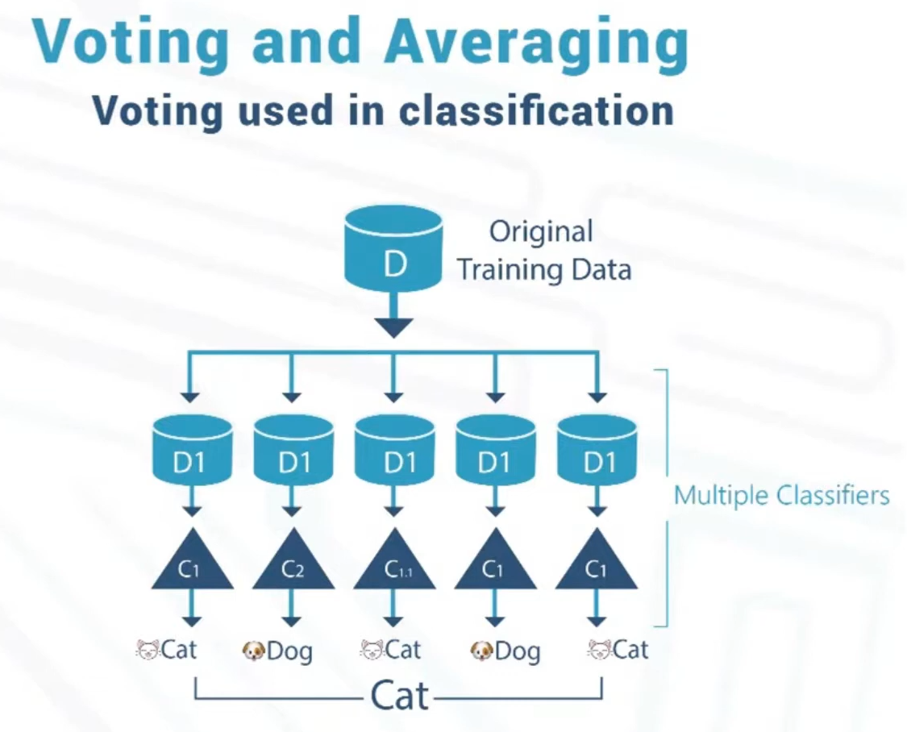
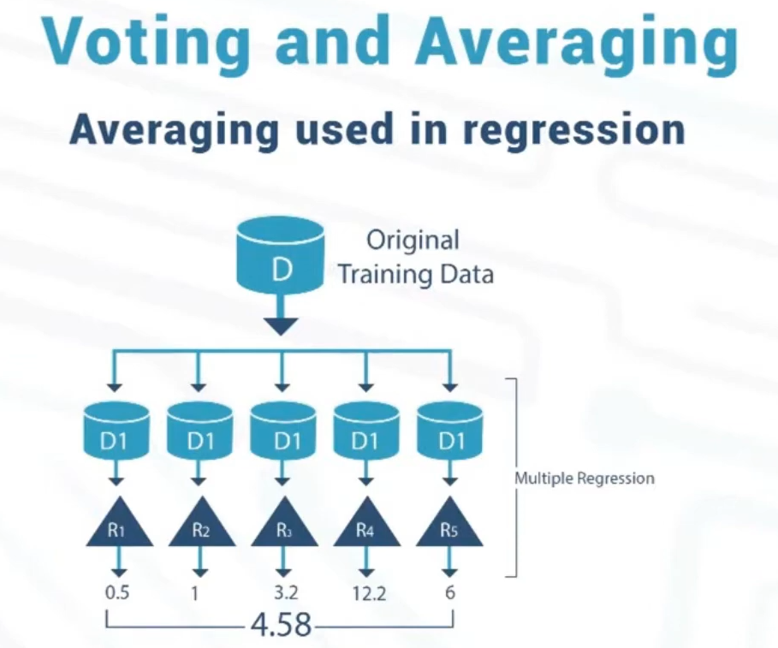
Voting and Averaging

Slide 5
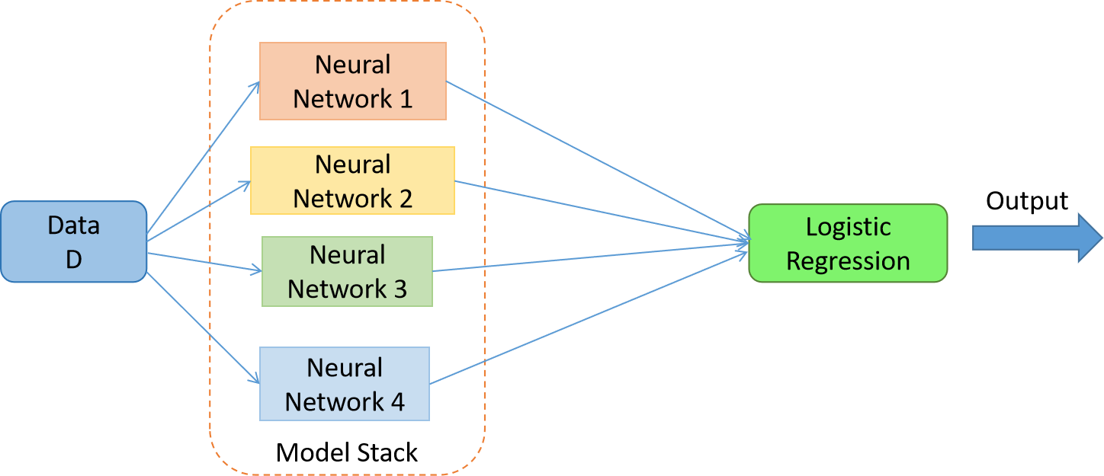
Stacking
I will train a dataset with different algorithms.
Then, we put the result prediction from training in a new-dataset.
After that ,we apply a new model at this new-dataset, which will output the overall enhanced prediction.

Slide 6
Bagging(Bootstrap Aggregation)
Bagging is mainly applied in supervised learning problems.
Designed to improve the accuracy and stability of machine learning algorithms.
It includes the following steps :
Data Sampling: Creating multiple subsets of the training dataset using bootstrap sampling (random sampling with replacement).
Model Training: Training a separate model on each subset of the data.
Aggregation: Combining the predictions from all individual models (averaged for regression or majority voting for classification) to produce the final output.
Ex: Random Forest uses bagging technique.

Slide 7
Advantages of Bagging
Reduces Variance: By averaging multiple predictions, bagging reduces the variance of the model and helps prevent overfitting.
Improves Accuracy: Combining multiple models usually leads to better performance than individual models.

Slide 8
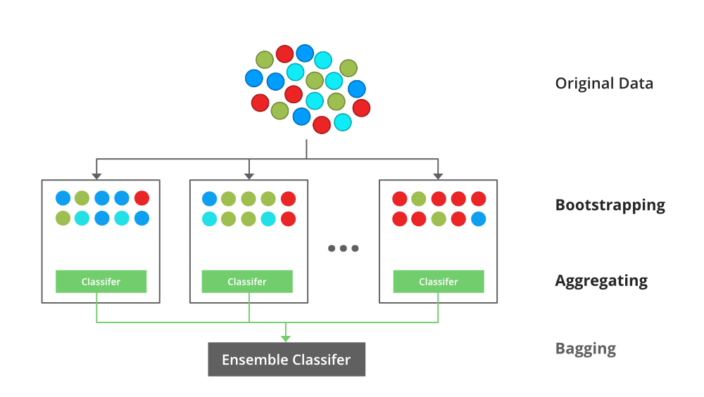
Bagging

Slide 9
Boosting
Focuses on creating a strong model by combining several weak models.
It involves the following steps:
Sequential Training: Training models sequentially, each one trying to correct the errors made by the previous models.
Weight Adjustment: Each instance in the training set is weighted. Initially, all instances have equal weights. After each model is trained, the weights of misclassified instances are increased so that the next model focuses more on difficult cases.
Model Combination: Combining the predictions from all models to produce the final output, typically by weighted voting or weighted averaging.

Slide 10
Advantages of Boosting
Reduces Bias: By focusing on hard-to-classify instances, boosting reduces bias and improves the overall model accuracy.
Produces Strong Predictors: Combining weak learners leads to a strong predictive model.

Slide 11
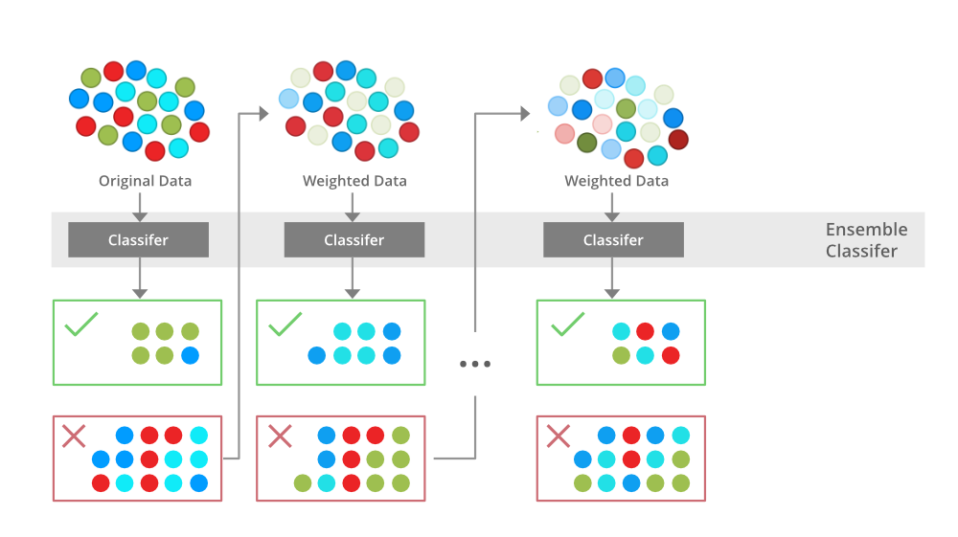
Boosting

Slide 12
Comparison Between Bagging & Boosting
Bagging
Boosting
Classifiers are trained parallelly.
If the classifier is high variance, then apply bagging.
Aim to decrease variance, not bias.
Bagging tries to solve the over-fitting problem.
classifiers are trained sequentially.
If the classifier is high bias the apply boosting.
Aim to decrease bias, not variance.
Boosting tries to reduce bias.

